Slide 1
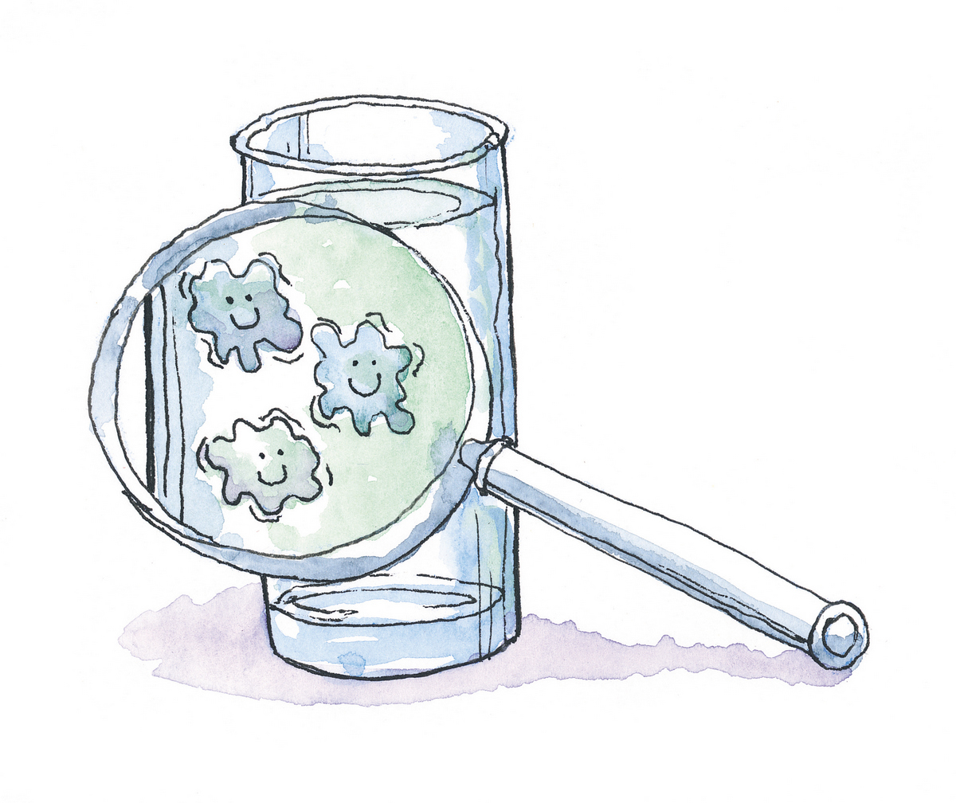


Rapid Detection and Quantification of Bacteria in Drinking Water Using Raman and Fluorescence Spectroscopies
Amir Nakar
Ze’ev Schmilovitch
Mikhail Borisover
Shlomo Sela (Saldinger)

Slide 2

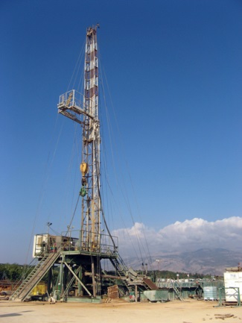
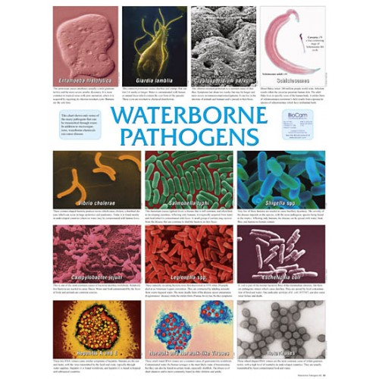
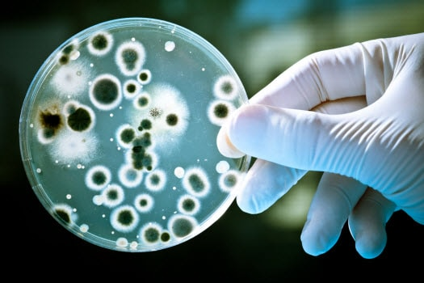


Microbial Water Contamination
Microbial water contaminations cause ~40,000 hospitalizations annually in the US*
Contamination is sporadic and can be caused at any point in the supply chain
Daily testing for microbial contamination
Standard methods take 12-72 hours to produce results
*Collier et al. Epidemiology and infection 2012; 140: 2003–2013.

Slide 3
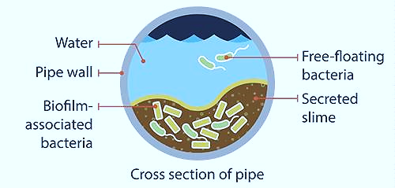
Industrial damage
Bio fouling
Corrosion
Blocking, flow changes
Recurrent contamination
Early detection → Early treatment → Prevent damage

Slide 4
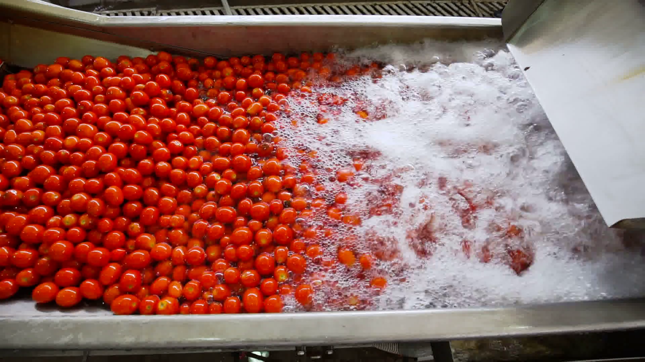
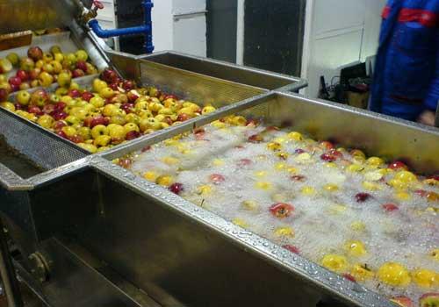
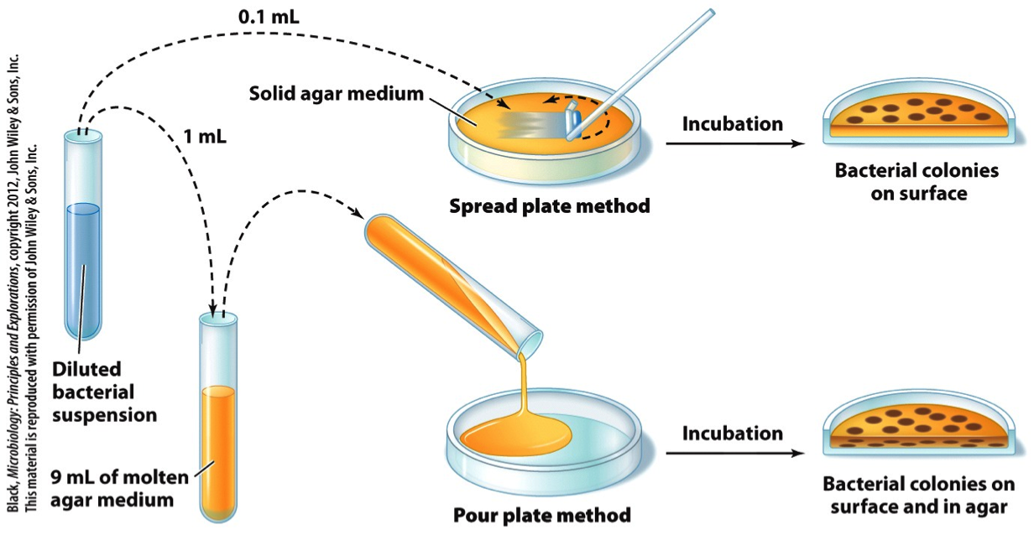
Post-harvest food safety
Estimation of contaminations in PRODUCE is done using similar methods
Microbial contamination of water in packing / washing facilities causes CROSS-CONTAMINATION of produce (fruit, vegetables, fish etc.)
Early detection → Early treatment → Prevent damage

Slide 5



Current Methods
Colony counting (CFU)
ELISA
Real-time PCR
Microscopy Cell counts
ATPase activity
…
There is a need for a
FAST, CHEAP, ACCURATE
Method for detection of bacteria in water
UGLY!

Slide 6
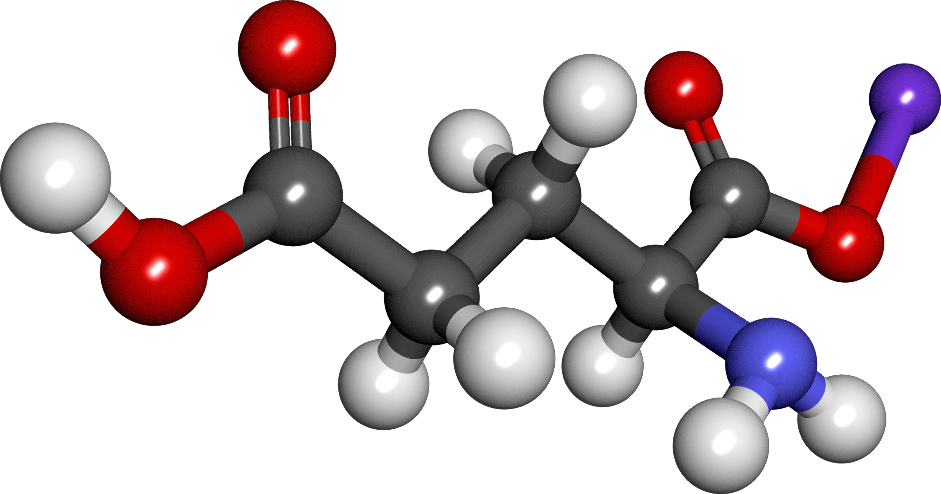

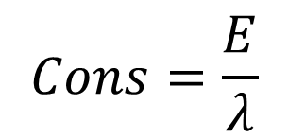

Spectroscopy
Excitation
$$ΔE$$
$$Cons=\frac{E}{λ}$$
These phenomena are specific – meaning each molecule has a “fingerprint”
Notes:
Raman slide
ADD Delta E

Slide 7
Hypothesis
It is possible to detect bacteria in concentrations of 10³ CFU/ml using Low Resolution Raman or fluorescence spectroscopy

Slide 8


Method
2ml
Measure change in $λ$
Entire procedure takes less than 5 minutes

Slide 9
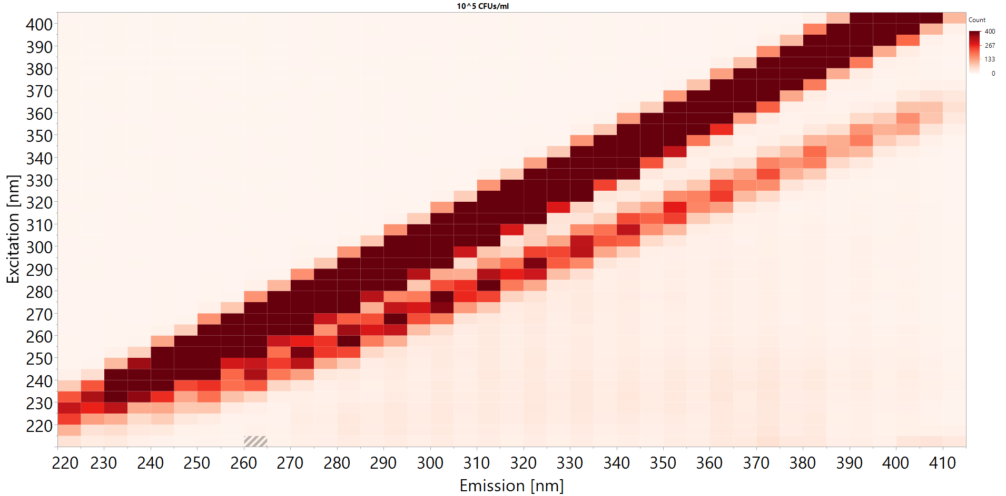
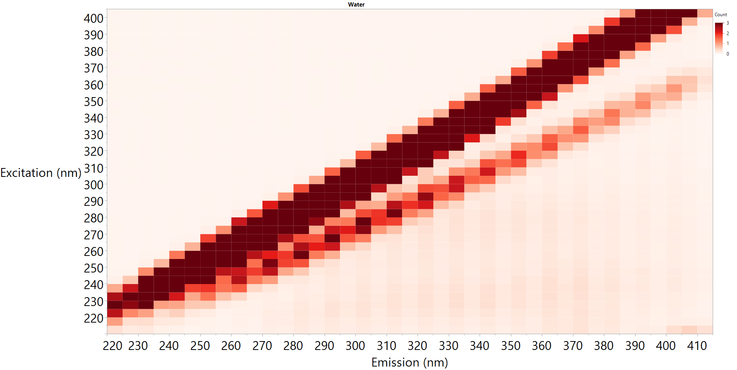
Initial Results - Water
Relative F.U
Notes:
3 graphs:
0 CFUs, 1,000 CFUs, 10⁷ CFUs

Slide 10
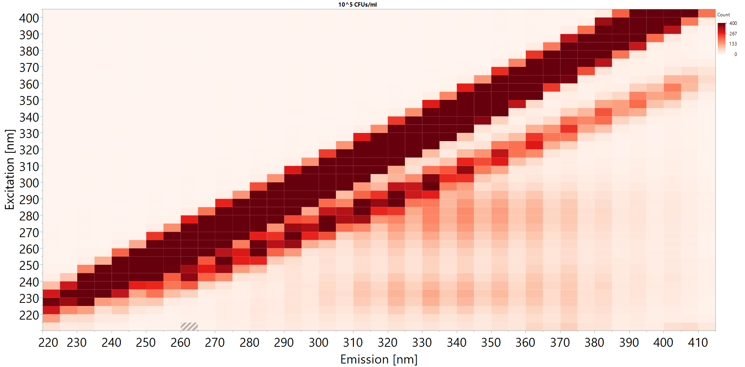
Initial Results – Finding peaks
Relative F.U
10⁵ CFU/ml

Slide 12
Partial least squares (pls)
Partial Least Squares enables you to predict a value based on a large set of variables
Using iterative process, the algorithm assigns weights for all the variables based on their relevance to the predicted variable
For example:
Variable 1 explains 10% of variance, Variable 2 explains 90% of variance
The prediction will be based on 0.1*V1 + 0.9*V2
V1
V1
V1
V2
PLS iterative algorithm
V2
V2
V3
Weights assignment
“Prediction Formula”
∑weights*values
Prediction
V3
V3
V4
V4
V4
…
…
…
Is your prediction correct? Is it robust?
Vn
Vn
Vn
Notes:
4. On the same issue, you said that "PLS defines which point is important in the input vector"
I wouldn't say that -- this is more PCA. In your case, when you have only one class it is somewhat true, but when you have several classes then you have one inputs (wavelengths) which have more weights to classify A while others have more weight to classify B.
Bottom line -- I would say "It allows to classify data by assigning weights (plural) to each wavelength"

Slide 13
Notes:
Add matrix multiplication

Slide 14
Validating the model
To make sure your model is relevant you test it on a VALIDATION set of data
This is data that is not modelled
It should be between 10-50% of your data to be significant (we used 30%)
All data = 100 samples
30
70
Validation set
Training set
Prediction
PLS Model

Slide 15
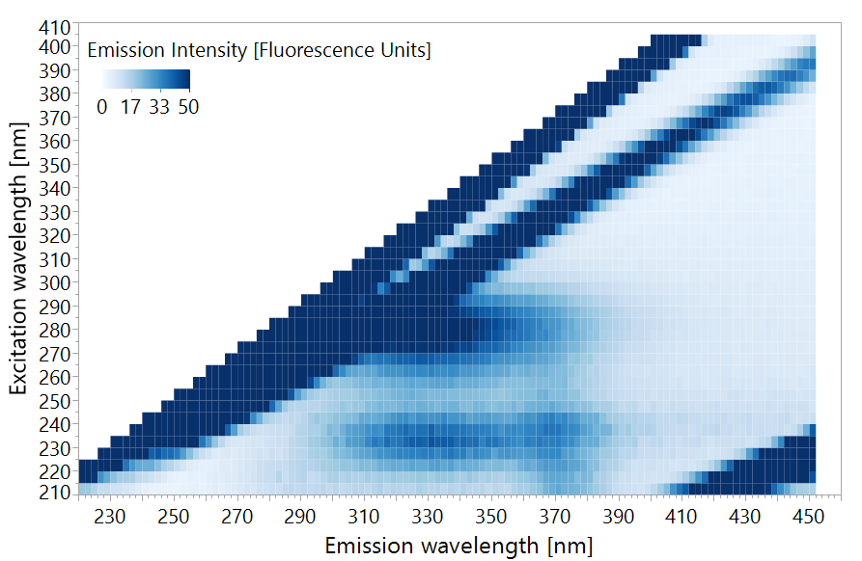
Fluorescence Spectroscopy
Notes:
I think that it is important to recognize the practical difference between Raman scattering and fluorescence.
If the energy of the photon is resonant with some molecular transition (meaning that it is equal to the energy difference between ground energy state and one of the excited states of the molecule), that the molecule can absorb this photon undergoing energy transition. Now, there are many things that can happen with the molecule in this excited state: it can lose some or all of its extra energy in collision with another molecule, it can fall apart if this extra energy is large enough or - if it avoids these things - it can emit extra energy as a photon which is called fluorescence. The energy of the emitted photon is not necessarily equal to the energy of the absorbed photon as the molecule can end up in a different energy state (for example, having more vibrational energy).
There is a reason that Raman process is called scattering. It is a non-resonant process so the energy of the photon is not important (although higher energies are more efficient in inducing Raman scattering). You can imagine molecule as a small antenna which receives electromagnetic radiation and can re-radiate this. In most cases, the molecule will scatter exactly the same energy - this is called Rayleigh scattering. In few cases, small part of this energy is stored in molecular vibration, or, if molecule is vibrationally excited, it can give this extra energy to the photon. When this happens, scattered light has a shift in wavelength and the process is called Raman scattering.
In contrast to fluorescence, there is no excited state in Raman scattering, therefore the process is almost instantaneous, whereas fluorescence has characteristic lifetime of nanoseconds. So, no matter how one can play with words, these two are very different processes and they totally deserve different names.

Slide 16
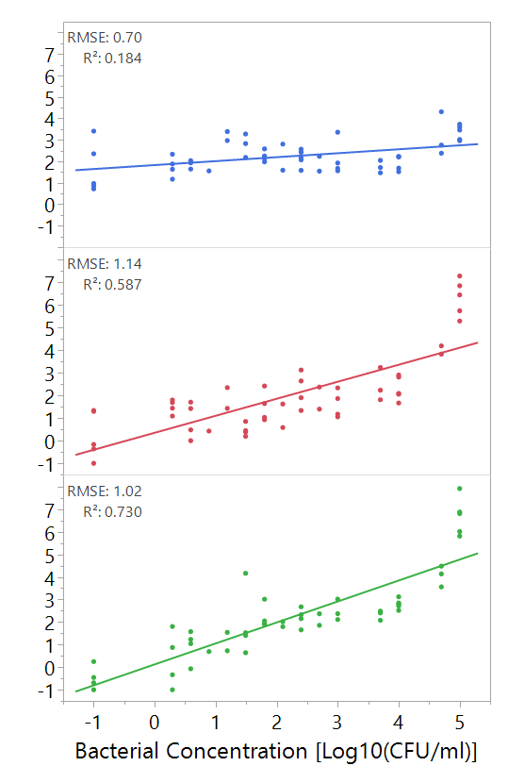
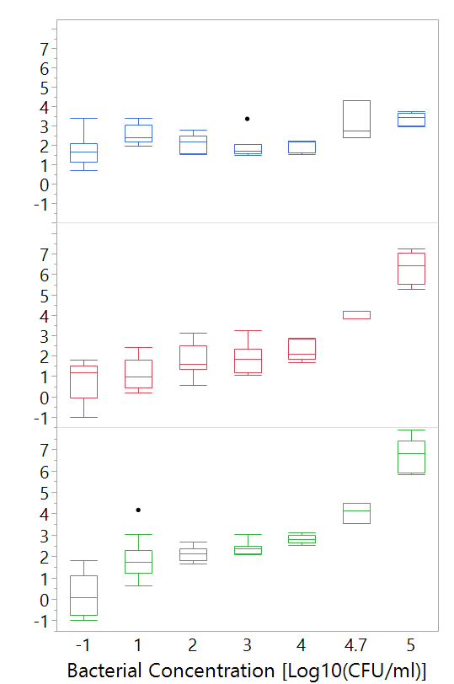
Detection with Fluorescence spectroscopy
Predicted
Concentration
[log10(CFU/ml)
Notes:
Figure 16. Left: regression of E. coli concentration with different detection methods, Right: box plot of the data as used for threshold analysis. Boxes illustrate median and interquartile range (IQR), whiskers indicate 25th and 75th percentile, outliers are shown as black dots. N=53.

Slide 17
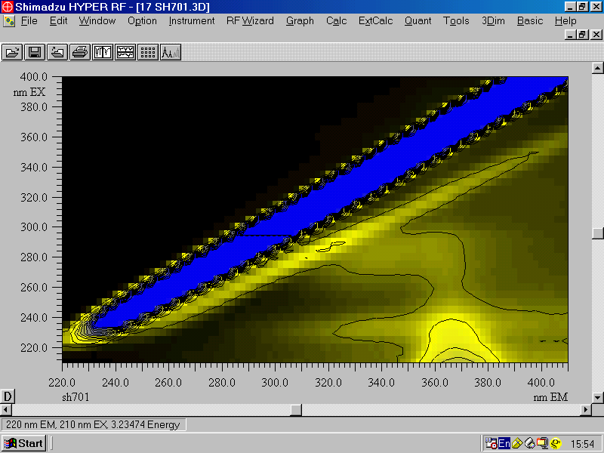
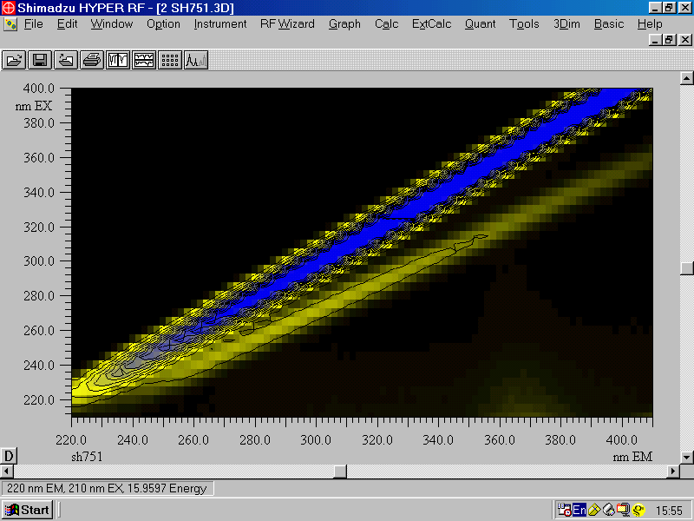
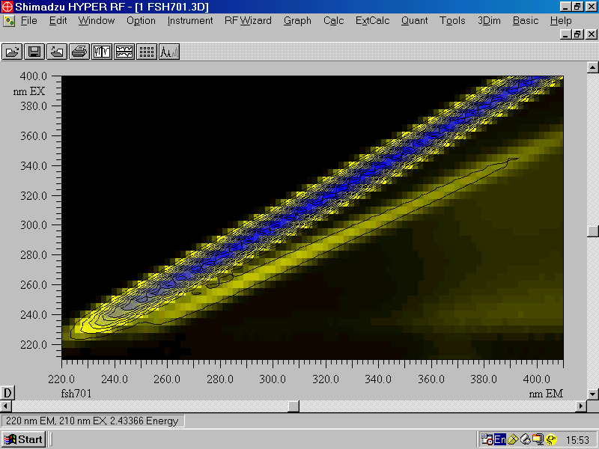
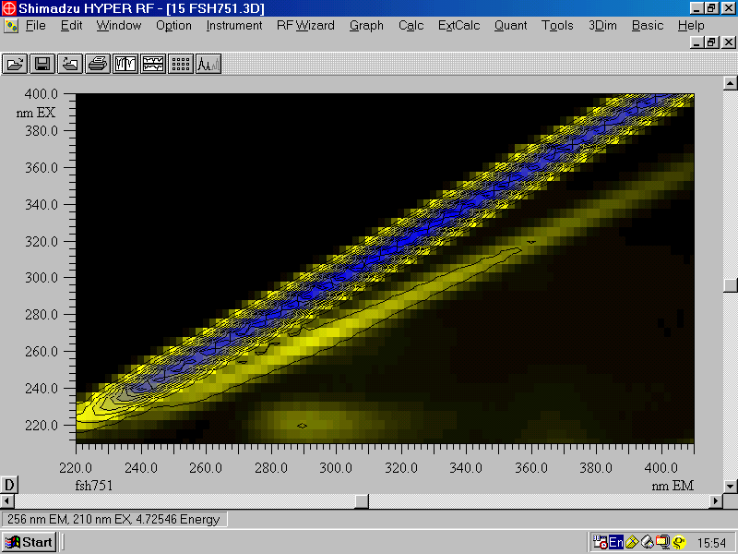
Fluorescence Spectroscopy
Raw
Chlorinated
Filtered
Chlorinated & Filtered

Slide 18
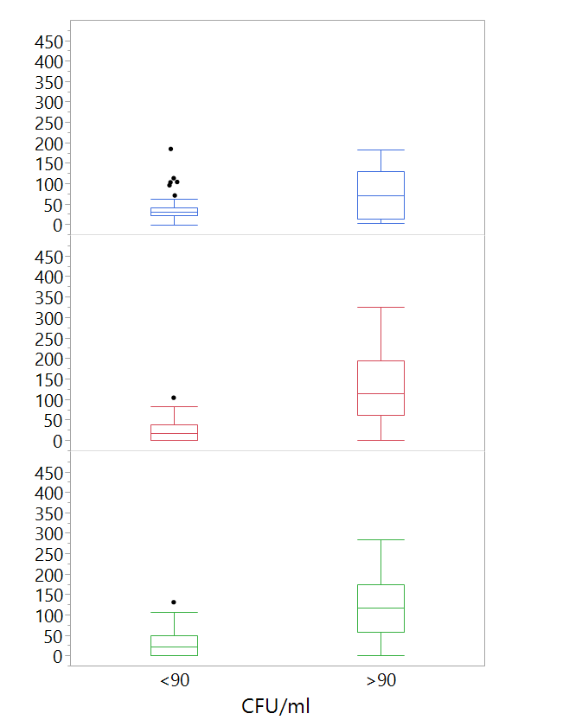
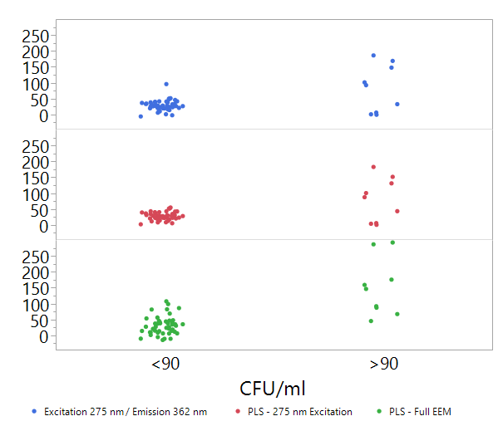
Predicted Bacterial Concentration [log10(CFU/ml)
*
*
Figure 17. Box plots of predicted heterotrophic bacteria concentrations using different fluorescence spectroscopy analysis approaches versus real heterotrophic bacteria counts in groundwater. Asterisks mark significant difference between groups according to a Wilcoxon test, p<0.01. n=57. Boxes illustrate median and interquartile range (IQR), whiskers indicate 25th and 75th percentile, outliers are shown as black dots.

Slide 19
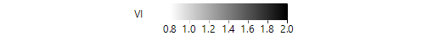
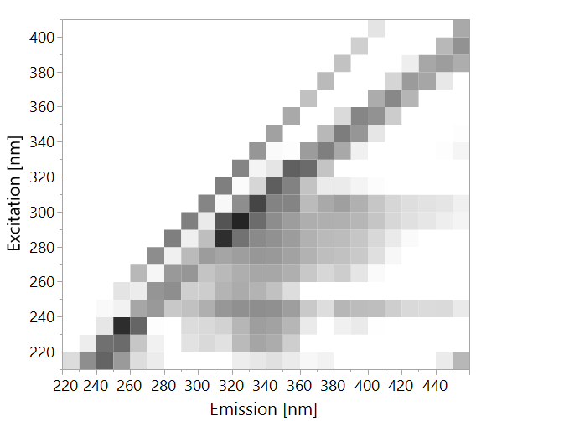
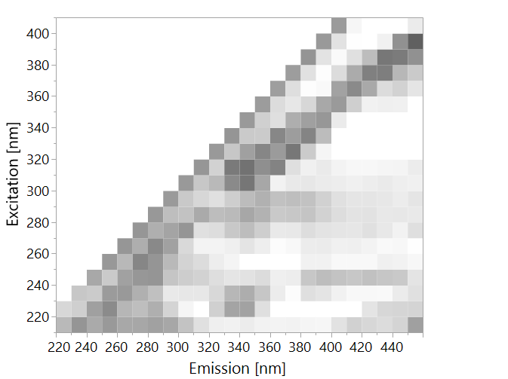
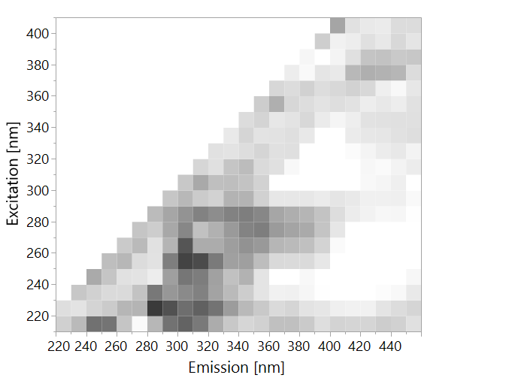
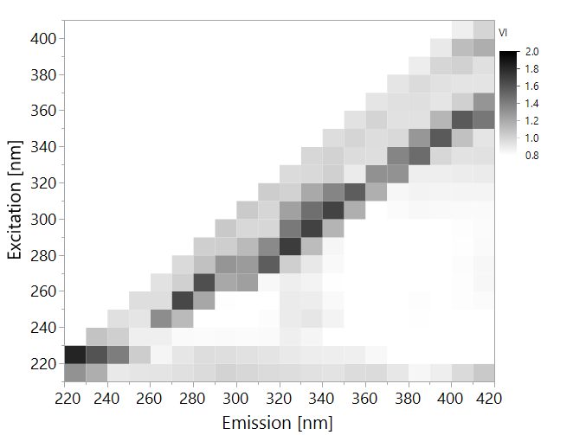
E. coli
B. subtilis
P. aeruginosa
Heterotrophic Bacteria
Figure 19. Variable importance (VI) plots of PLS models made from entire EEMs. The plots show only values >0.8.

Slide 20
 | Prediction κ =0.78
Actual |  | B. subtilis | E. coli | P. aeruginosa | Water | Total
 | B. subtilis | 8 | 0 | 0 | 0 | 8
 | E. coli | 0 | 8 | 0 | 1 | 9
 | P. aeruginosa | 0 | 0 | 5 | 7 | 12
 | Water | 0 | 0 | 1 | 50 | 51
 | Total | 8 | 8 | 6 | 58 | 80

Slide 21
Initial Results – Finding peaks
Relative F.U
280/332
Figure 4. EEM of E. coli suspended in distilled water at a concentration of 10⁵ CFU/ml. The intensity has been cutoff at 50 fluorescence units to enhance visibility.
225/336
210/370
10⁵ CFU/ml

Slide 22
Initial Results – Finding peaks
210/370
225/336
280/332
R² = 0.52
R² = 0.65
R² = 0.69
* n = 46
Notes:
Maybe swtich to 10^{X}…

Slide 23
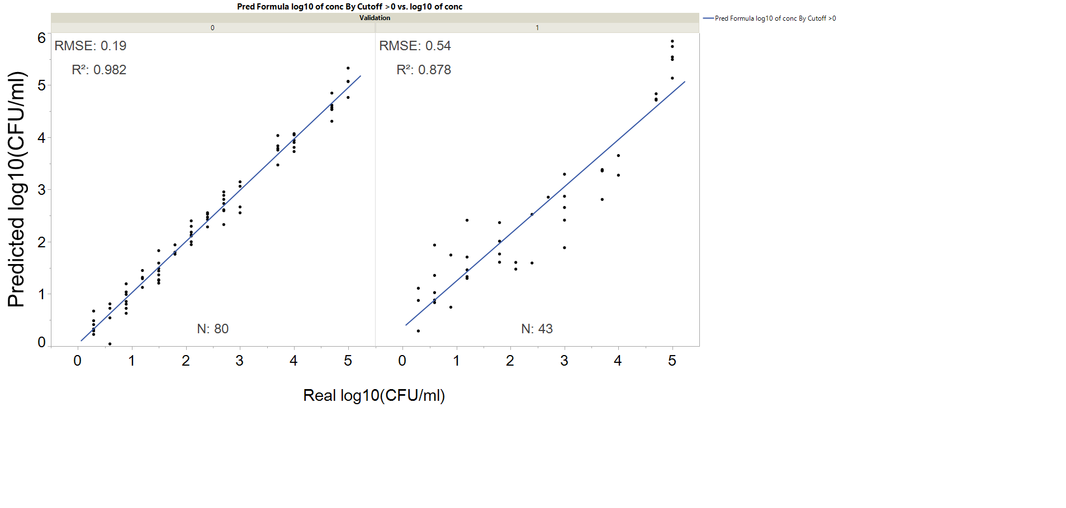
Model results - quantification
Training Set
Validation Set

Slide 24

Hypothesis
It is possible to detect bacteria in concentrations of 10³ CFU/ml using quick, low resolution fluorescence spectroscopy
Using fluorescence spectroscopy, coupled with a PLS-based prediction model, we can quickly detect bacteria at a concentration of 10² CFU/ml
In a model system…
Notes:
Add “thumbs up” in model system

Slide 25

from the bench to the FIELD using real Water samples
We received groundwater samples from the north
150 samples over 9 months
Samples were sent to a service lab for standard tests:
Total count (heterotrophic bacteria)
Total coliforms, fecal coliforms and fecal streptococci
Samples were scanned for fluorescence in our lab
Heterotrophic plate count of over 1,000 CFU/ml is an indicator for contamination

Slide 26
Summary
Fluorescence spectroscopy can be a robust tool for detection of E. coli in a model system
No single wavelength is a good predictor
Using PLS analysis on many combinations of wavelengths can is required to get high resolution results
The method is applicable to real drinking water

Slide 27
Conclusions
Fluorescence spectroscopy, coupled with machine learning algorithms, can be used to detect bacteria in water.
The method is applicable to real drinking water
Detection is based on natural fluorescence of tryptophan, tryptophan derivatives and other (probably organic) molecules.
It is possible to detect bacteria in concentrations of 10³ CFU/ml using quick, low resolution fluorescence spectroscopy

Slide 28


Thanks
Department of Soil Chemistry
Mikhail Borisover
Nadia Buchanovsky
Emir Haleva
Dalit Vaizel-Ohayon
Volcani Center
Institute of Agricultural Engineering
Ze’ev Schmilovitz
Timea Ignat
Department of Food Quality and Safety
Shlomo Sela
Yulia Krupitzky
All the Sela lab team

Slide 29
Findings
Low-resolution Raman spectroscopy yielded low detection sensitivity (≥10⁶ CFU/ml for E. coli and ≥10² CFU/ml for B. subtilis)
For the purpose of discriminating between different species of bacteria in dense suspensions (≥10⁷ CFU/ml), analysis of Raman shift spectra enabled significant discrimination between E. coli and B. subtilis as well as pure water
Fluorescence spectroscopy can detect bacterial presence in water quickly and accurately
Extending fluorescence analysis from measuring emission at a single excitation-emission wavelength pair to emission spectrum at a certain excitation wavelength and further to use of EEM, resulted in a significant improvement of the limit of detection.
A PLS-based chemometric method improved the sensitivity by several orders of magnitudes,
this is the first study to measure the effect of extending the analysis from single wavelength pair to full EEM on microbial detection threshold
Fluorescence was capable of detecting ≥1 CFU/100 ml of E. coli contamination in one sample out of 99.
A PLS model based on EEM data enabled detection of HPC in concentration of ≥100 CFU/ml (HPC).
full EEM analysis of fluorescence data enabled differentiation between E. coli, B. subtilis and P. aeruginosa, though not as well between P. aeruginosa and pure water.

Slide 30
Questions?
 | Training | Validation | Overall
Detection % >100 CFU/ml | 100% | 99% | 99%
False positive % (n) | 0 (0) | 2 (1) | 1 (1)
False Negative % (n) | 0 (0) | 0 (0) | 0 (0)

Slide 31
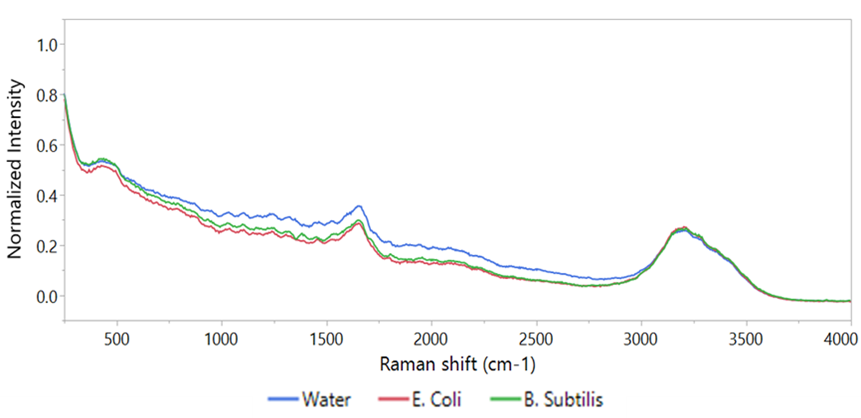
Raman spectra of bacteria
Notes:
Figure 6. An example of the Raman spectra of clean double-distilled water, E. coli at a concentration of 10⁸ and B. subtilis at a concentration of 10⁷ CFU/ml. Excitation is by 785 nm laser, for 5 seconds, 3 scans were averaged.

Slide 32
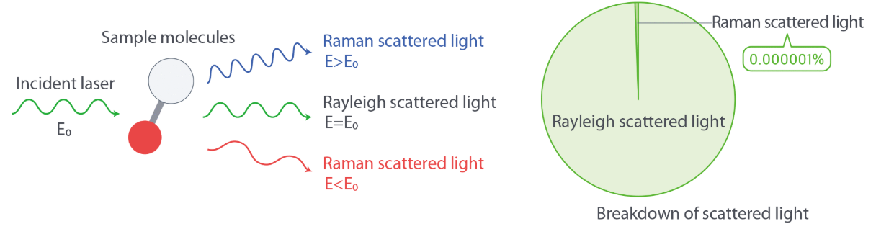
Low resolution RAMAN SPECTROSCOPY
Inelastic scattering of incident radiation (laser) through interaction with vibrating molecules
Low Resolution = No surface enhancement or microscopes; direct application of laser to sample

Slide 33
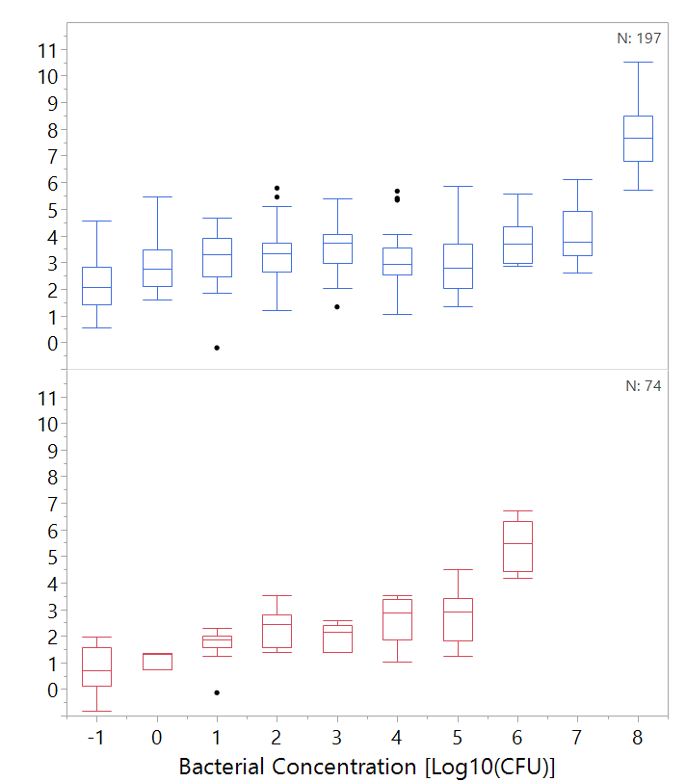
Detection with low resolution raman spectroscopy
*
*
*
Maybe remove astrix?
E. coli
N=197*
Predicted Bacterial Concentration
Log10[log10(CFU/ml)
*
*
*
*
*
B. subtilis
N=74*
We can detect both species clearly only at a concentration of 10⁶ CFU/ml
* Only validation set is shown
Notes:
Figure 7. Left: regression of predicted bacterial concentration according to PLS model against real bacterial concentration of E. coli and B. subtilis. Right: box plot of the data as used for threshold analysis. Boxes illustrate median and interquartile range (IQR), whiskers indicate 25th and 75th percentile, outliers are shown as black dots. Asterisks signify diffrence from control (concentration of 0 CFU/ml) according to Student's t-test, p<0.01 .N of E. coli = 197, N of B. subtilis = 74. Only validation set is shown.

Slide 34
Discrimination between species
 | Prediction
Actual |  | B. subtilis | E. coli | Water | Total
 | B. subtilis | 18 | 0 | 1 | 19
 | E. coli | 0 | 18 | 0 | 18
 | Water | 2 | 0 | 28 | 30
 | Total | 20 | 18 | 29 | 67
A separate prediction model was trained
sample contains E. coli, B. subtilis or just water?
Bacteria were at a concentration of 10⁶⁻⁸ CFU/ml
The model made nearly perfect predictions (κ=0.93)
Notes:
Table 4. Confusion matrix of classification of bacteria by PLS-DA, based on Raman spectra, at concentrations 10⁸ and 10⁶ CFU/ml for E. coli and B. subtilis respectively. Only validation set is displayed. Cohen's kappa coefficient displayed at the top (κ).

Slide 35

Hypothesis
Watch your numbers!
It is possible to detect bacteria in concentrations of 10³ CFU/ml using Low Resolution Raman or fluorescence spectroscopy
Low-resolution Raman spectroscopy yielded low detection sensitivity
(≥10⁶ CFU/ml for E. coli and ≥10² CFU/ml for B. subtilis)

Slide 36
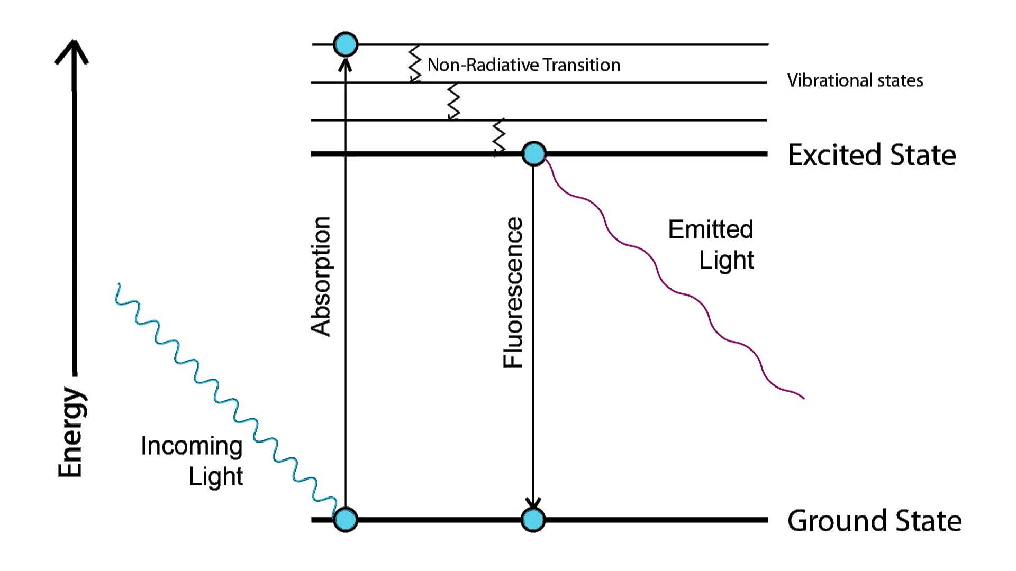
Fluorescence Spectroscopy
Notes:
I think that it is important to recognize the practical difference between Raman scattering and fluorescence.
If the energy of the photon is resonant with some molecular transition (meaning that it is equal to the energy difference between ground energy state and one of the excited states of the molecule), that the molecule can absorb this photon undergoing energy transition. Now, there are many things that can happen with the molecule in this excited state: it can lose some or all of its extra energy in collision with another molecule, it can fall apart if this extra energy is large enough or - if it avoids these things - it can emit extra energy as a photon which is called fluorescence. The energy of the emitted photon is not necessarily equal to the energy of the absorbed photon as the molecule can end up in a different energy state (for example, having more vibrational energy).
There is a reason that Raman process is called scattering. It is a non-resonant process so the energy of the photon is not important (although higher energies are more efficient in inducing Raman scattering). You can imagine molecule as a small antenna which receives electromagnetic radiation and can re-radiate this. In most cases, the molecule will scatter exactly the same energy - this is called Rayleigh scattering. In few cases, small part of this energy is stored in molecular vibration, or, if molecule is vibrationally excited, it can give this extra energy to the photon. When this happens, scattered light has a shift in wavelength and the process is called Raman scattering.
In contrast to fluorescence, there is no excited state in Raman scattering, therefore the process is almost instantaneous, whereas fluorescence has characteristic lifetime of nanoseconds. So, no matter how one can play with words, these two are very different processes and they totally deserve different names.

Slide 37
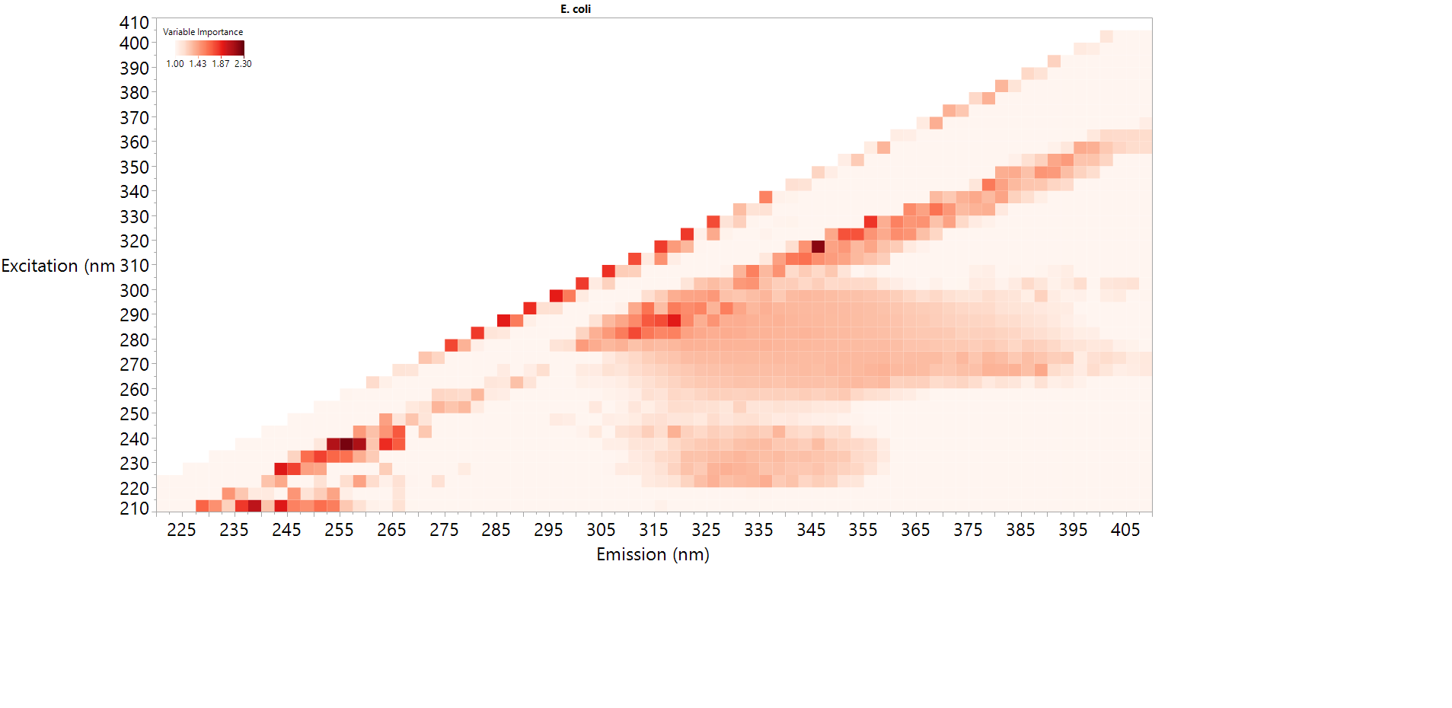
What is the molecular fingerprint? E. coli

Slide 38
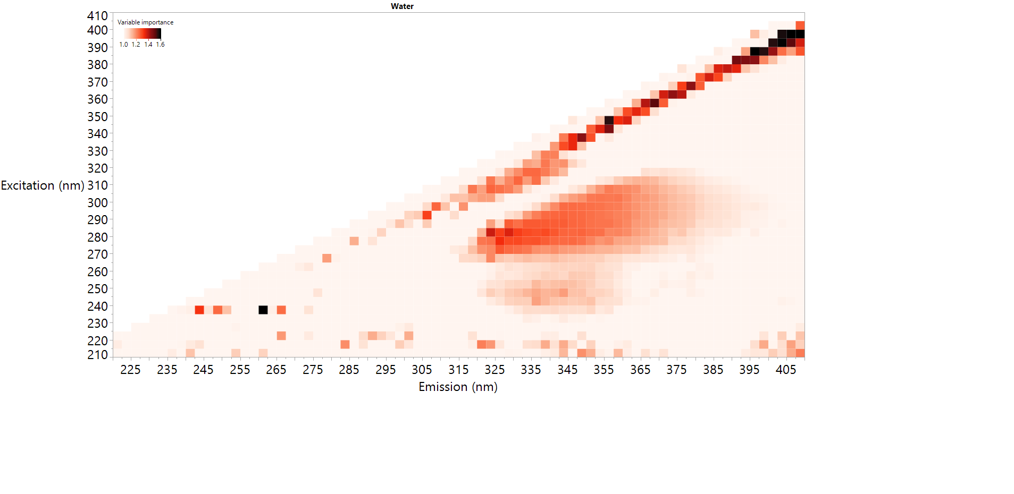
What is the molecular fingerprint? Heterotrophic Bacteria

Slide 39
What is the molecular fingerprint?
Heterotrophic Bacteria
E. coli
Tryptophan-like fluorescence → Proteins / protein derivatives*
Microbial humic substances*
???
*Yang et al. Environmental Science and Pollution Research 2015; 22: 6500-6510.

